Slide 1
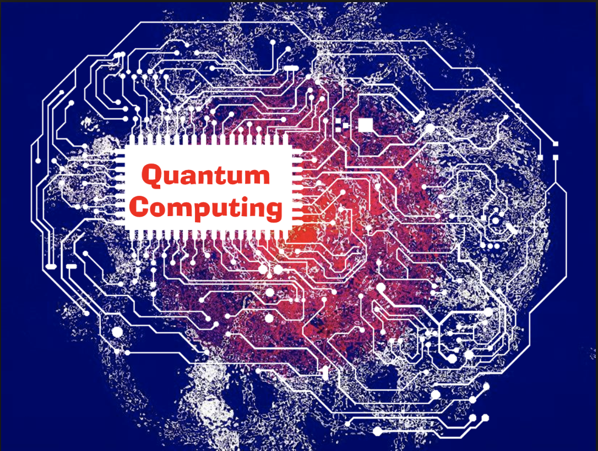
Quantum Deep Learning
Undergraduate Study #8-9
Hanjin Choi, Myungwoo Song. Korea University, School of Electrical Engineering
zxa018@korea.ac.kr
erados@korea.ac.kr

Slide 2
목차
Introduction to GAN
Paper review
- Quantum Generative Adversarial Learning
-Quantum Generative Adversarial Networks

Slide 3
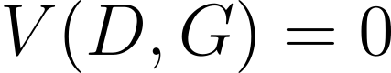

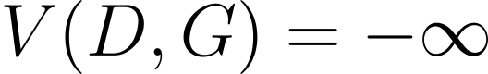
Introduction to GAN
Generative Adversarial Network
Generator 와 Discriminator 가 서로 경쟁하며 Sample 과 유사한 분포를 학습하는 네트워크
Generator
Generate
The discriminator should return 1 for true data and 0 for generated data. In this case .
The generator should make the discriminator to return 1 for generated data. In this case,
.
Generated?
Real sample?
Sampling
Real Sample
Discriminator

Slide 4
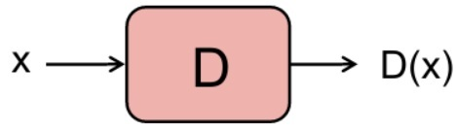
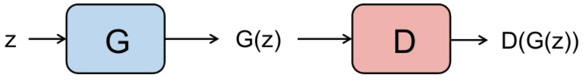
General Model of GAN
Real image
Generator
Discriminator
Fake or Real
Latent code
Fake image
https://niklasjang.github.io/ml/GAN-0/

Slide 5
Training GAN
Train D to classify real images as real
Real image
Generator
Discriminator
Fake or Real
Train D to classify fake images as fake
Latent code
Fake image

Slide 6
Training GAN
Real image
Generator
Discriminator
Fake or Real
Train G to deceive D
Latent code
Fake image

Slide 7
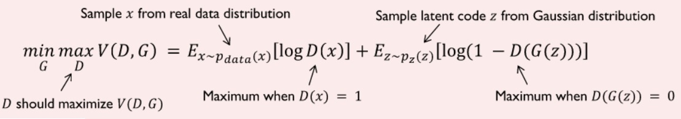
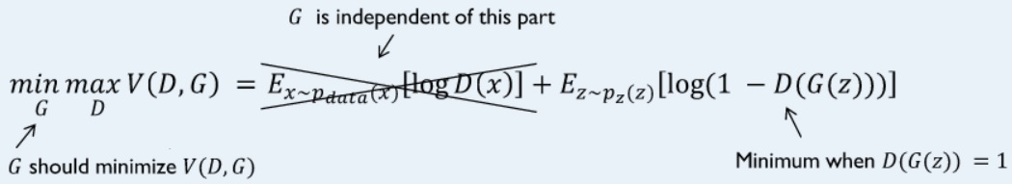
Loss Function fo GAN
Discriminator
Generator

Slide 8
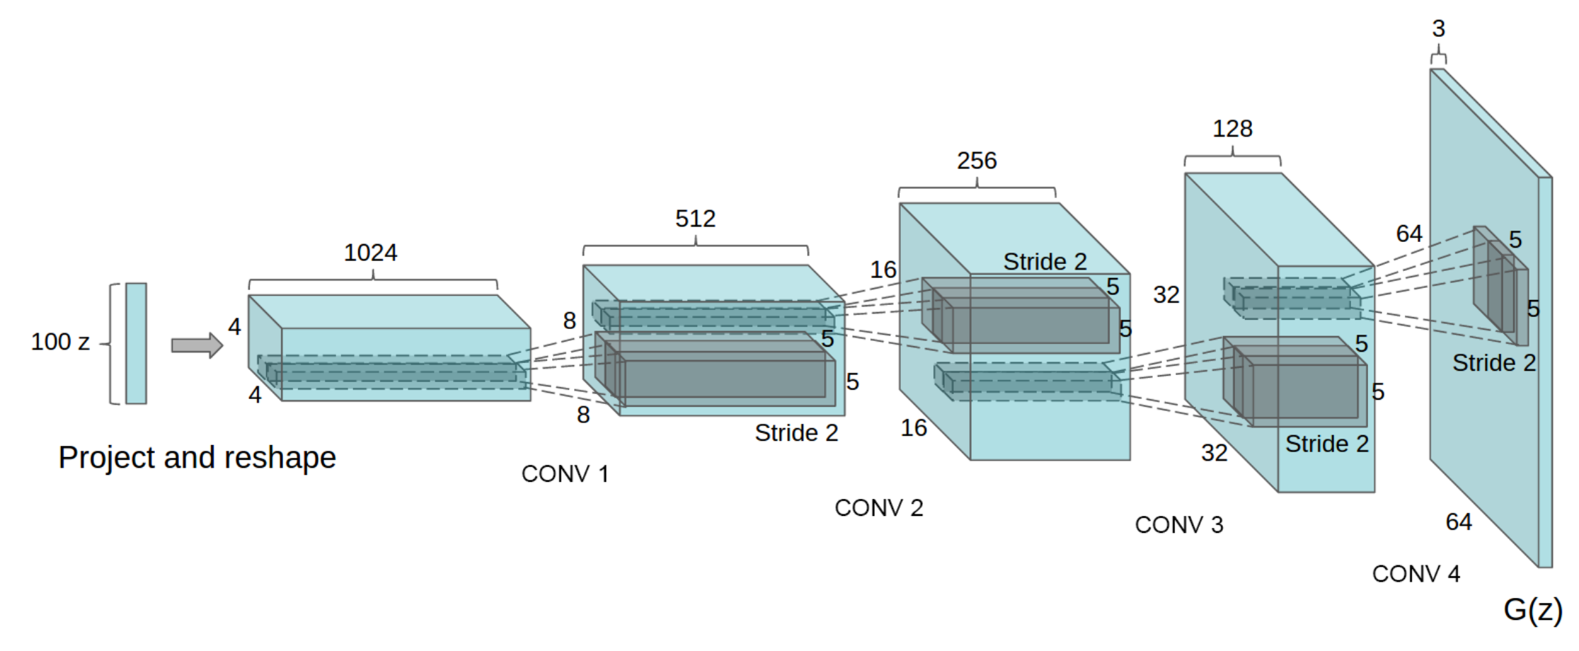
DCGAN
DCGAN is a direct extension of the GAN using convolutional and convolutional-transpose layers in the discriminator and generator.
Generator modeling
https://arxiv.org/pdf/1511.06434.pdf

Slide 9
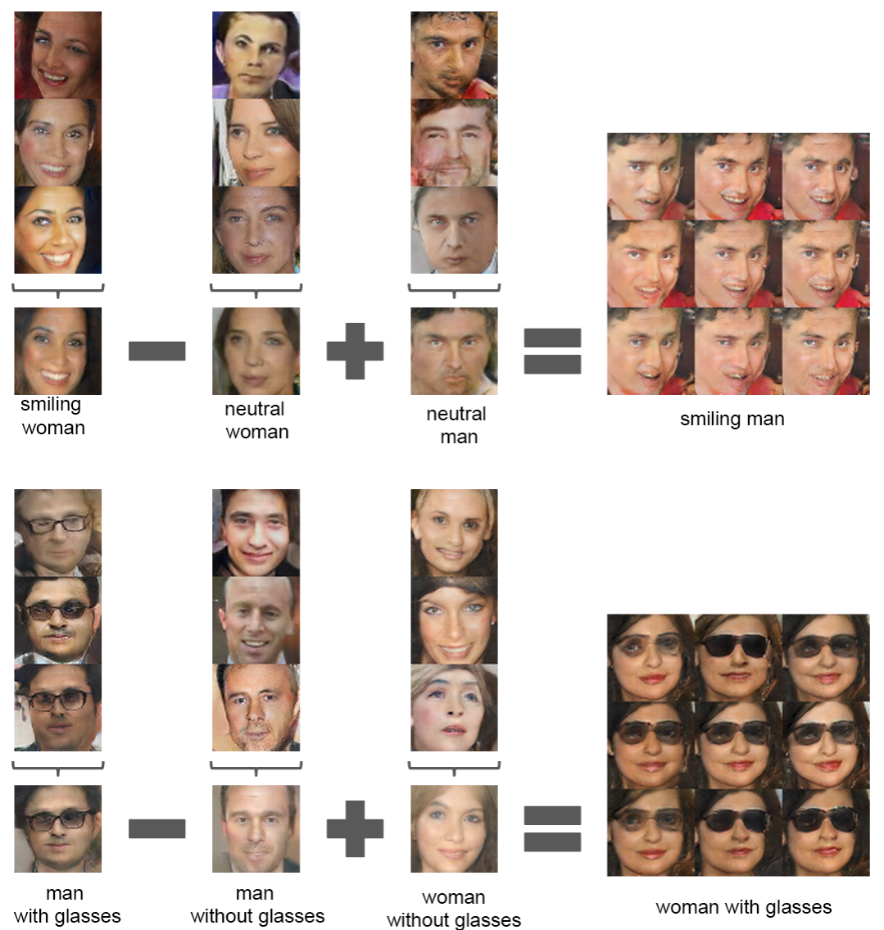
DCGAN
Arithmetic was performed on the averaged Z vectors(latent code) of samples then, generator generates right hand side images.
Z vectors have meaningful data that represents image.
https://arxiv.org/pdf/1511.06434.pdf

Slide 10
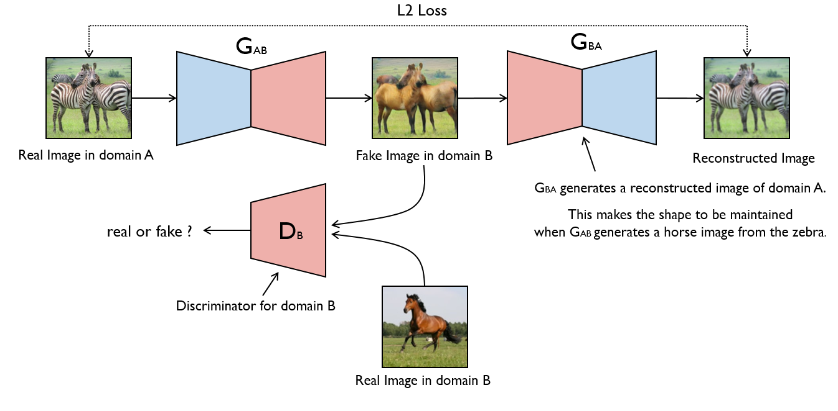
CycleGAN
CycleGAN is an approach to training deep convolutional networks for Image-to-Image translation task.
https://modelzoo.co/model/mnist-svhn-transfer

Slide 11
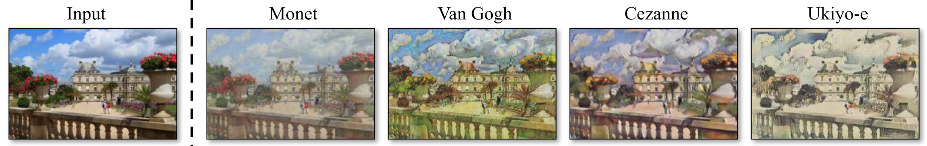
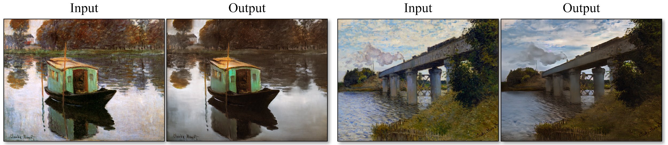
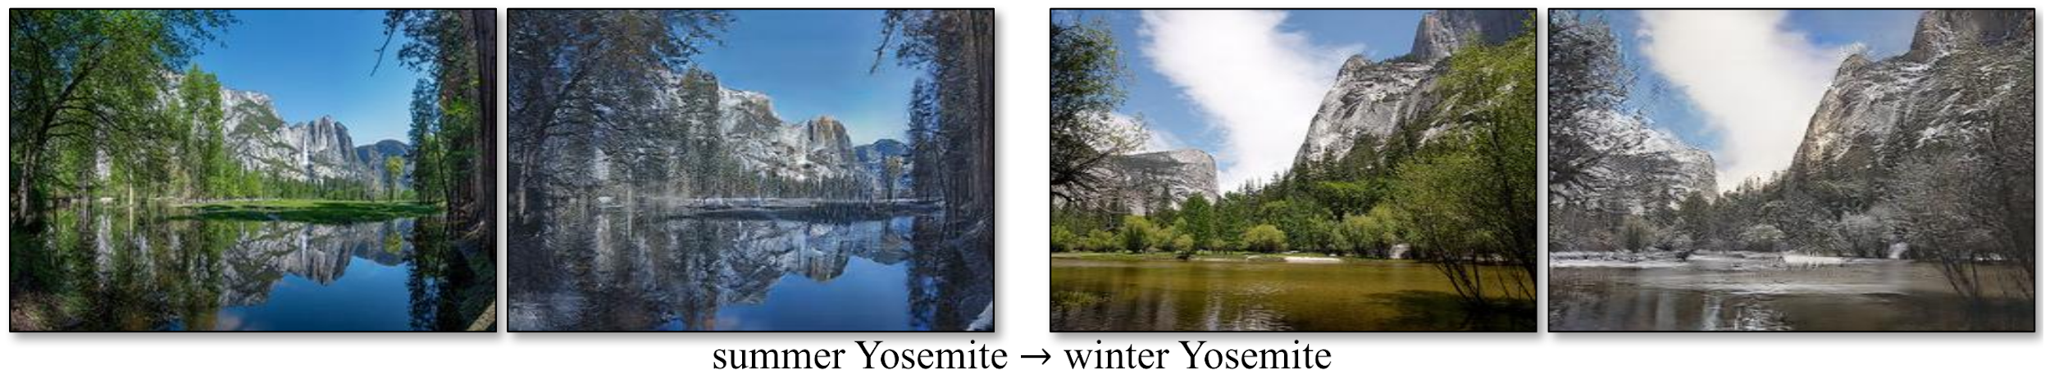
CycleGAN - applications
Collection style transfer
Photo generation from paintings
Season transfer
https://arxiv.org/pdf/1703.10593.pdf

Slide 12
Quantum Generative Adversarial Learning
Introduction to GAN
Paper review
- Quantum Generative Adversarial Learning
- Quantum Generative Adversarial Networks

Slide 13
Quantum Generative Adversarial Learning
Goal : Proof of feasibility of QGAN, comparison with classical GAN
Case I
Quantum Data
Quantum Discriminator
Quantum Generator
Case II
Quantum Data
Quantum or Classical Discriminator
Classical Generator
Case III
Real Data
Quantum Discriminator
Quantum Generator

Slide 14
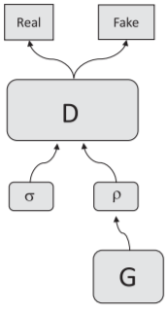
Case I
QGAN은 input 으로 quantum state 을 받아 discriminating measurement 를 수행한다. 이 때 Gradient descent 등을 사용하여 optimal minimum error measurement 를 학습한다. 판별기는 T 혹은 F (T+F=I)를 출력으로 하는 판별 오퍼레이터 D 를 가지는데 1-norm 이 1보다 작으므로 Convex 하여 minimum error measurement 를 찾을 수 있다. 실제 데이터를 density matrix σ로 생성되는 데이터를 density matrix ρ로 표현한 그림이 우측에 나와있으며 ρ 또한 Convex 하여 error 를 최대화 시킬 수 있다. 따라서 GAN 과 동일한 결과를 얻을 수 있다.
학습은 다음과 같이 이루어진다.
생성 전략을 고정하여 σ 와 ρ 를 구별하도록 판별기를 학습시킨다.
판별 전략을 고정하여 판별기를 속이도록 생성기를 학습시킨다.
판별기가 T 를 출력할 확률이 0.5 가 될 때까지 1~2를 반복한다.

Slide 15
Case II
Quantum real data 를 만드는 system 이 quantum supremacy 를 가진다면 classical generator 는 실제 데이터의 분포를 따라 할 수 없으며 이 때 discriminator 의 operator 가 convex 하므로 minimum error measurement 를 찾을 수 있다. 즉, discriminator 가 항상 real / false data 를 구분할 수 있다.
하지만 만약 그 system 이 quantum supremacy 를 가지지 않는다면 classical generator 는 실제 데이터의 분포를 따라 할 수 있다.
또 하나의 포인트는 discriminator 를 위한 알려진 nonexponential classical algorithm 이 없어서 quantum processor 를 사용하는 경우에만 minimum error measurement 를 찾을 수 있다는 것이다. 아래의 표는 이를 정리한 것이다.
- | Type of discriminator | Distribution | Result
Quantum Supremacy | Quantum | σ ≠ ρ | D wins
 | Classical | σ ≠ ρ | -
No Quantum Supremacy | Quantum | σ = ρ | Tie
 | Classical | σ = ρ | Tie

Slide 16
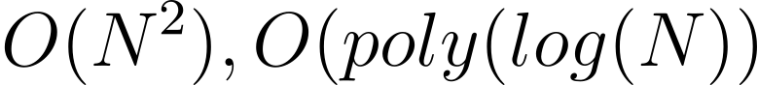
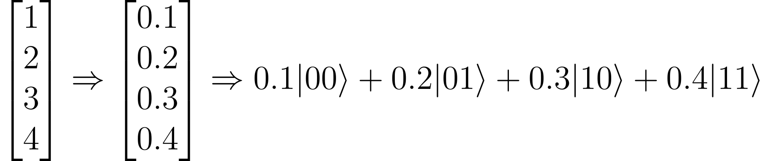
Case III
다루는 데이터의 종류가 classical 할 때 양자 컴퓨터가 고전 컴퓨터보다 이점을 지니는 지 확인하는 것이 Case III 이다. N dimensional 벡터를 나타내기 위해 고전 컴퓨터는 N 개의 bit 이 필요하나 양자 컴퓨터는 log N 개의 qubit 만으로 동일한 벡터의 unit vector 를 표현할 수 있다.
따라서 시간복잡도가 각각 로 양자 컴퓨터가 훨씬 좋은 성능을 보인다.
N dimensional 벡터를 log N 큐빗으로 나타내는 방법은 벡터의 크기를 1로 정규화 한 뒤 i th 성분을 i_{<2>} 에 대응하는 큐빗들의 상태에 진폭으로 인코딩하면 된다.
Conclusion : QGAN 은 작동가능한 알고리즘이며 고전적 GAN 보다 지수적인 성능의 향상이 있다.

Slide 17
Quantum Generative Adversarial Networks
Introduction to GAN
Paper review
- Quantum Generative Adversarial Learning
- Quantum Generative Adversarial Networks

Slide 18
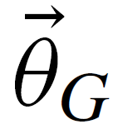
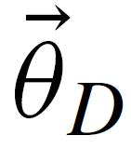
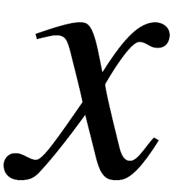
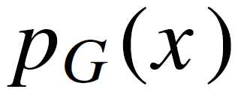
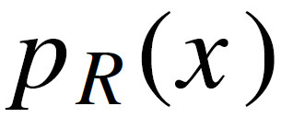
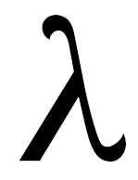
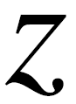
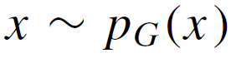
Classical GAN
Classical GAN
: vector of real-valued generator parameters
: vector of real-valued discriminator parameters
: data sample
: the distribution of generator
: fixed distribution came from the real-world data, generated by some process R
: label
: input of generator
The generator produces fake data samples
The discriminator classifies real and fake data samples, outputting a binary random variable.

Slide 19
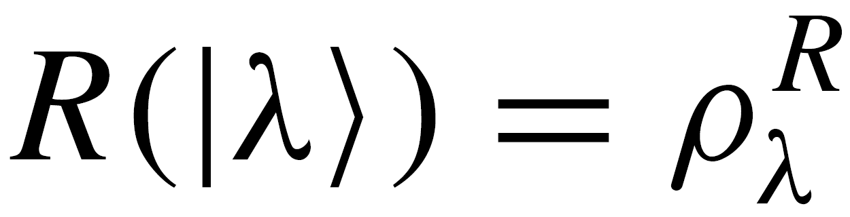
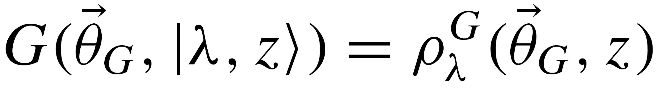
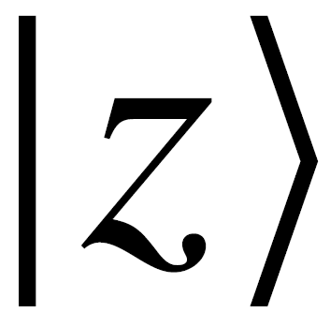
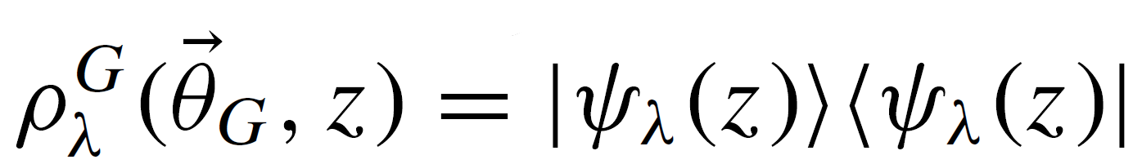
Quantum GAN
Quantum GAN
: R outputs density matrix
: The generator generates a quantum state
The role of input state is twofold
providing entropy within the distribution of generated data
serving as a control for the generator
The generator which is unitary, can produce a fixed state
Role of generator and discriminator is same as classical GAN.

Slide 20
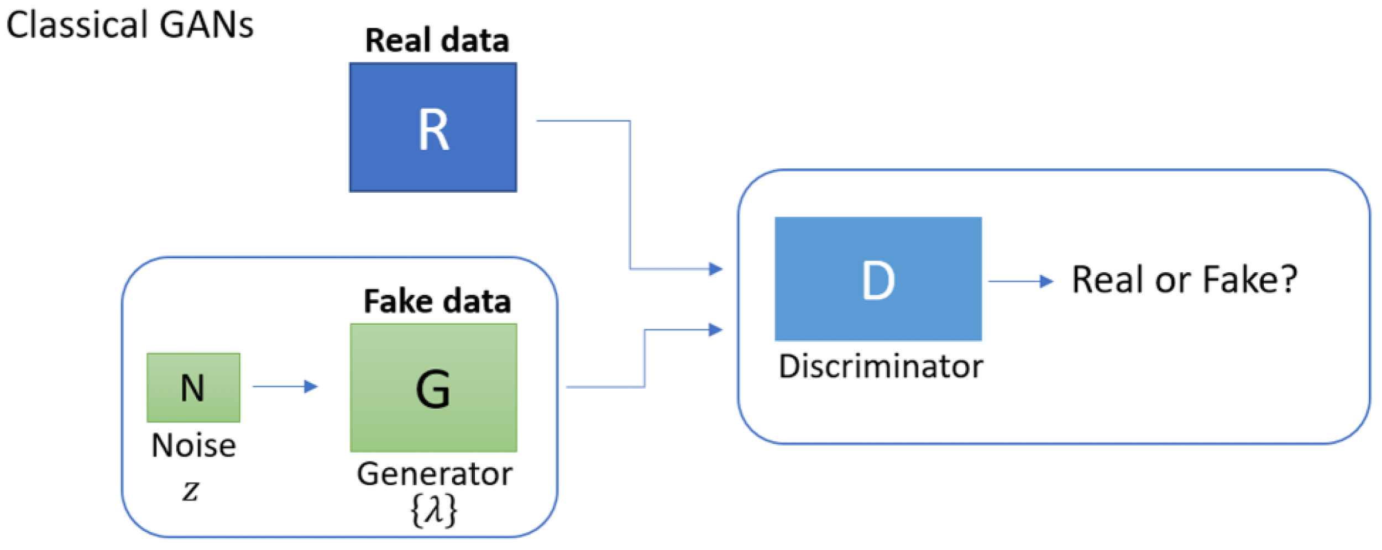
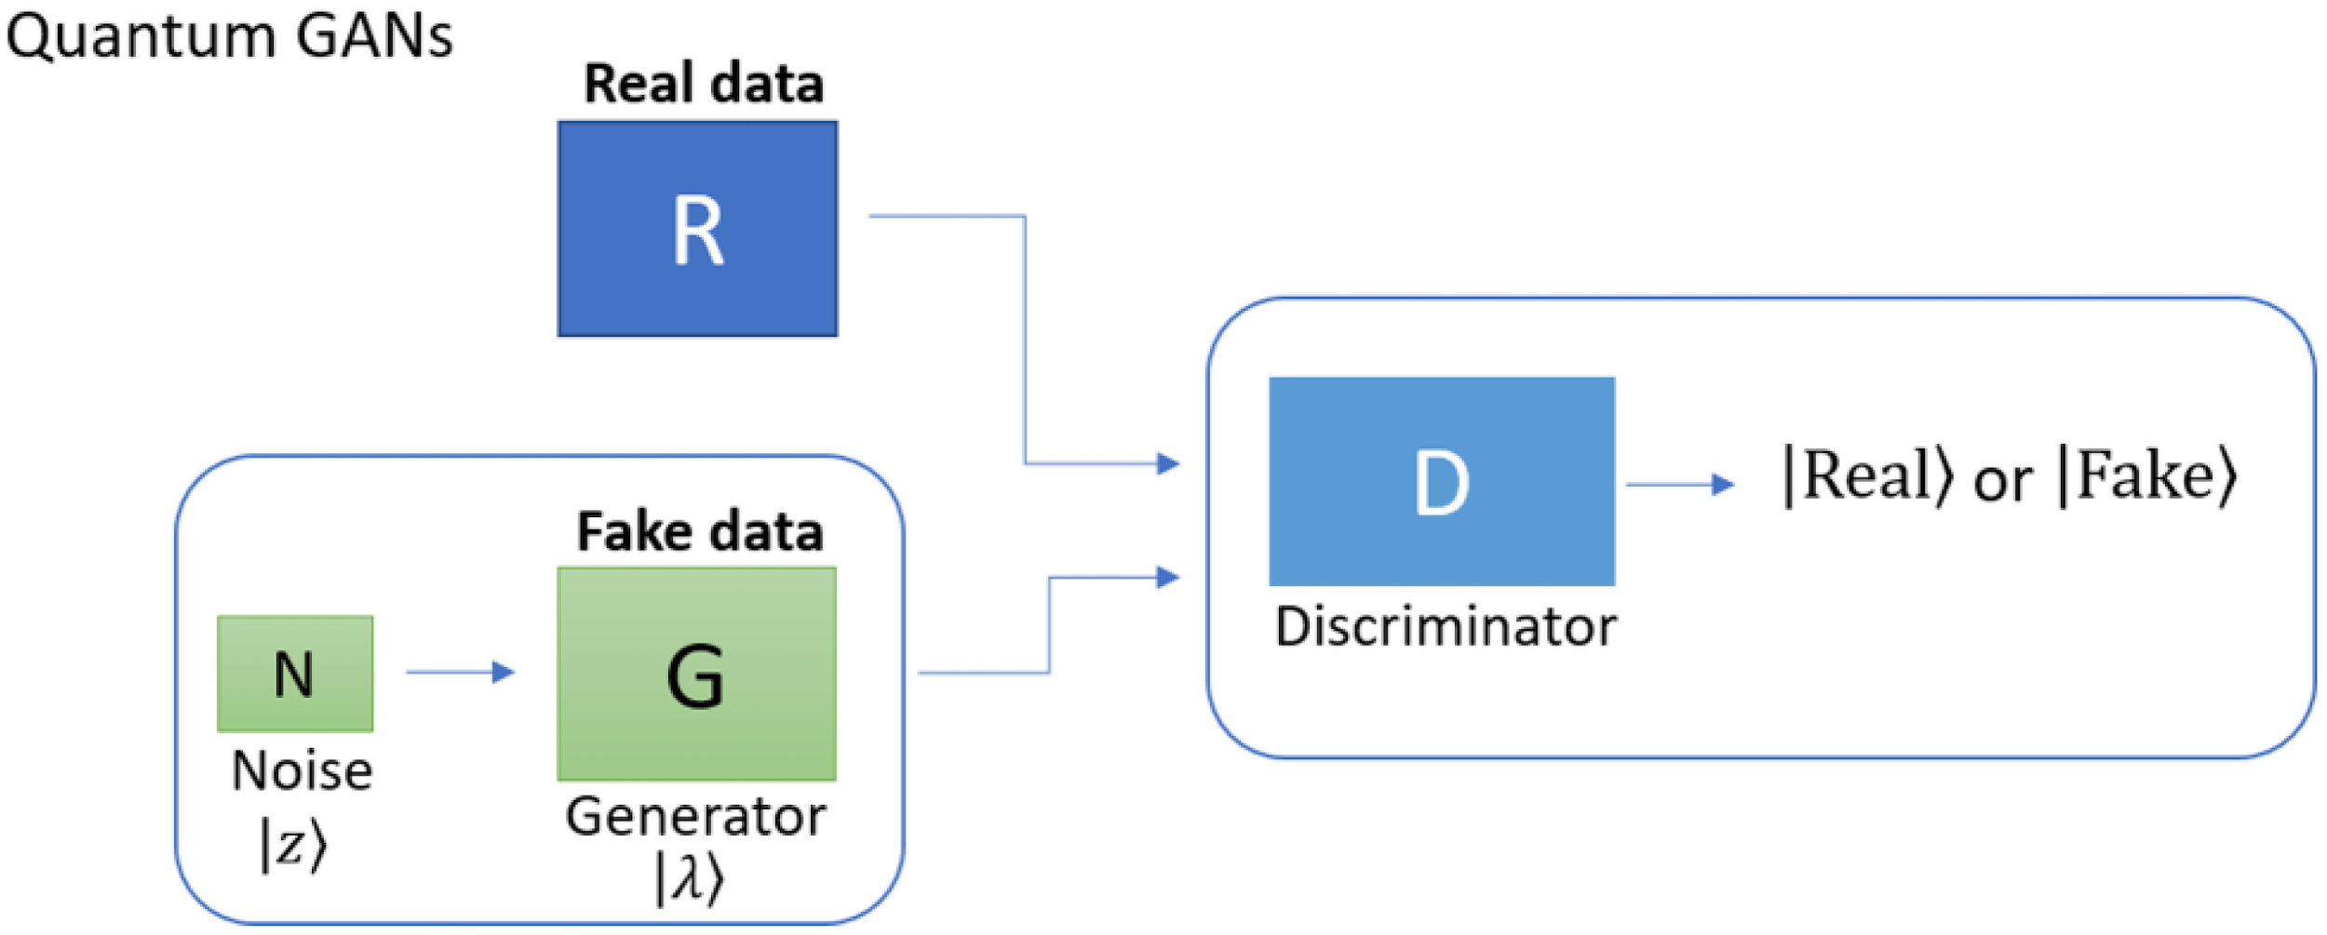
Block Diagrams of Classical & Quantum GANs
A discriminator D must determine whether the samples are produced by a real source R or a generator G.
A quantum discriminator D must decide whether the quantum state comes from a real quantum data source R or a quantum generator G.

Slide 21
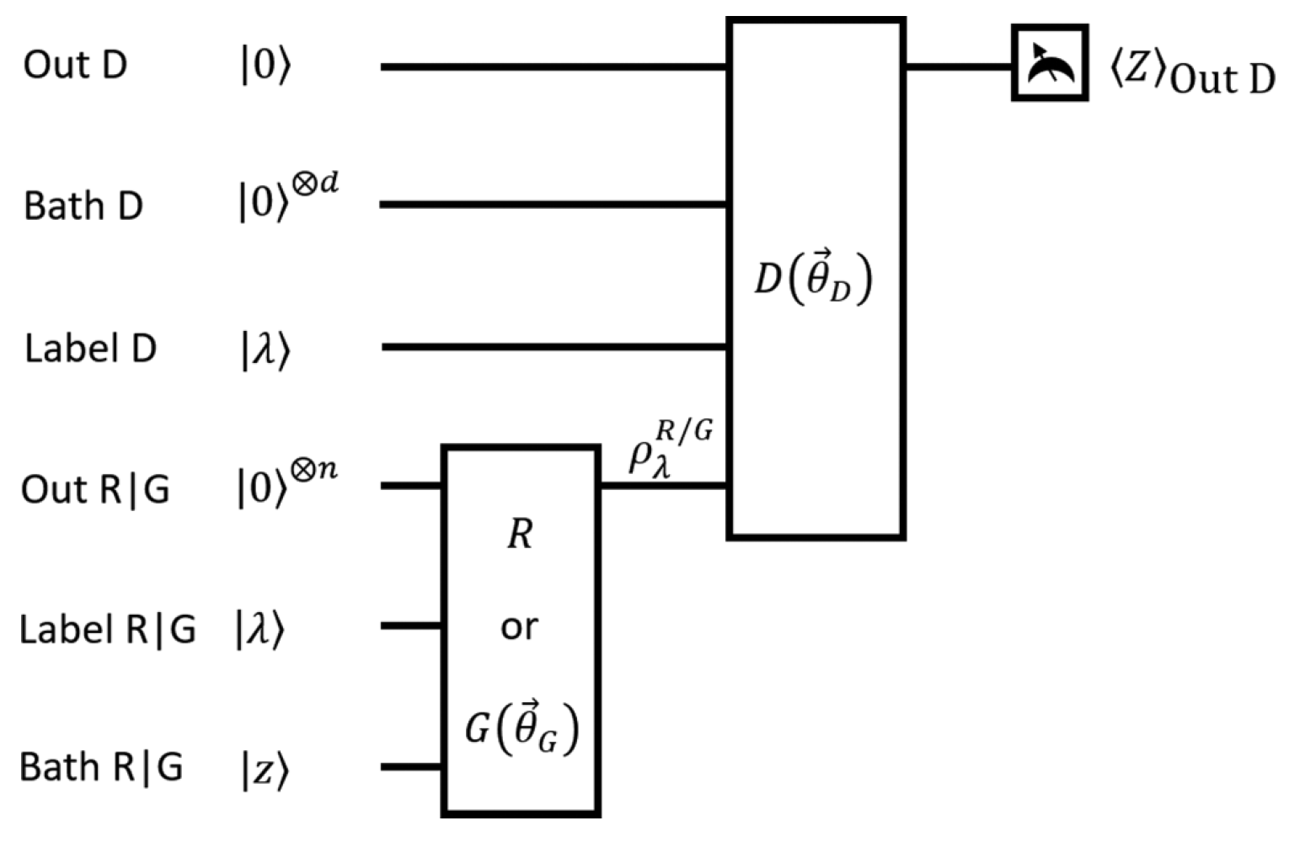
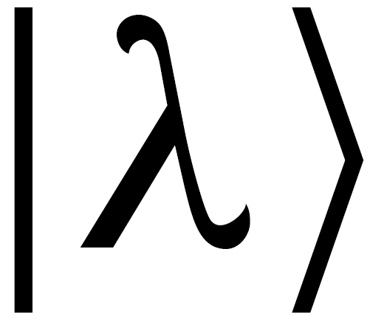
The General Structure of QuGANs
Out D is answer |real⟩ or |fake⟩
Bath D is workspace
Label D is reference copy of the
Out R|G is output of generator or R
Label R|G is label
Bath R|G is a noise vector

Slide 22
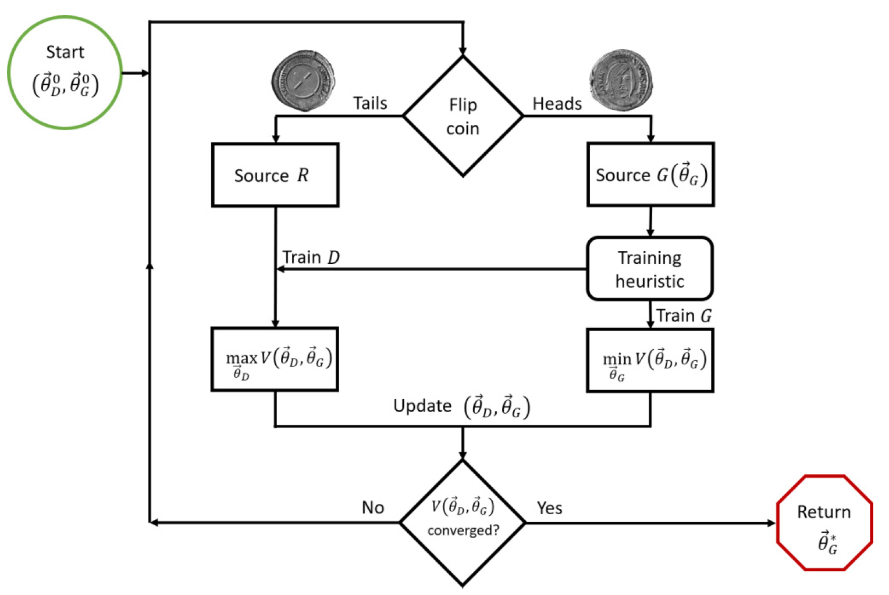
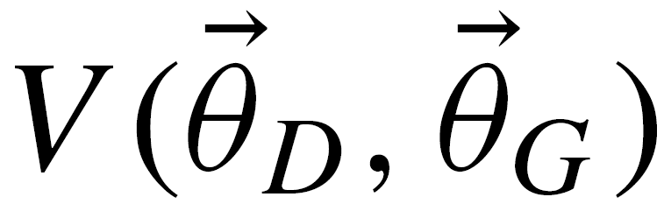
Algorithmic flow of the training of a QuGAN
To run this algorithm cost function is needed.

Slide 23
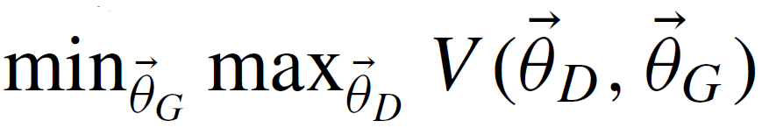
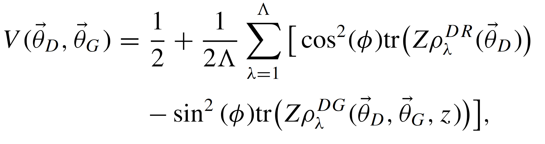
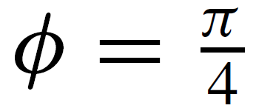
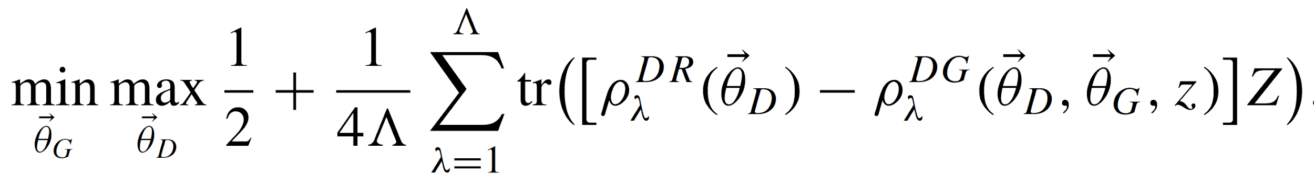
Optimization Objective
Cost Function

Slide 24
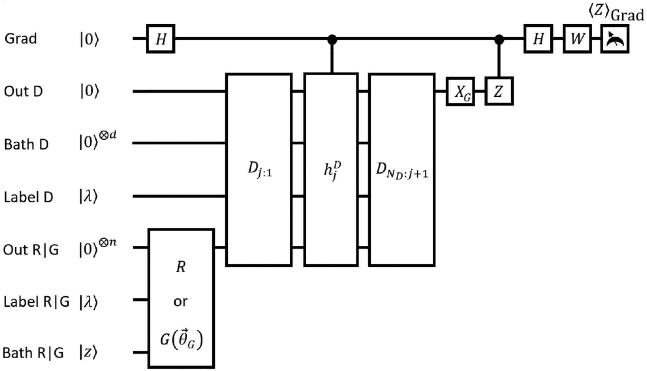
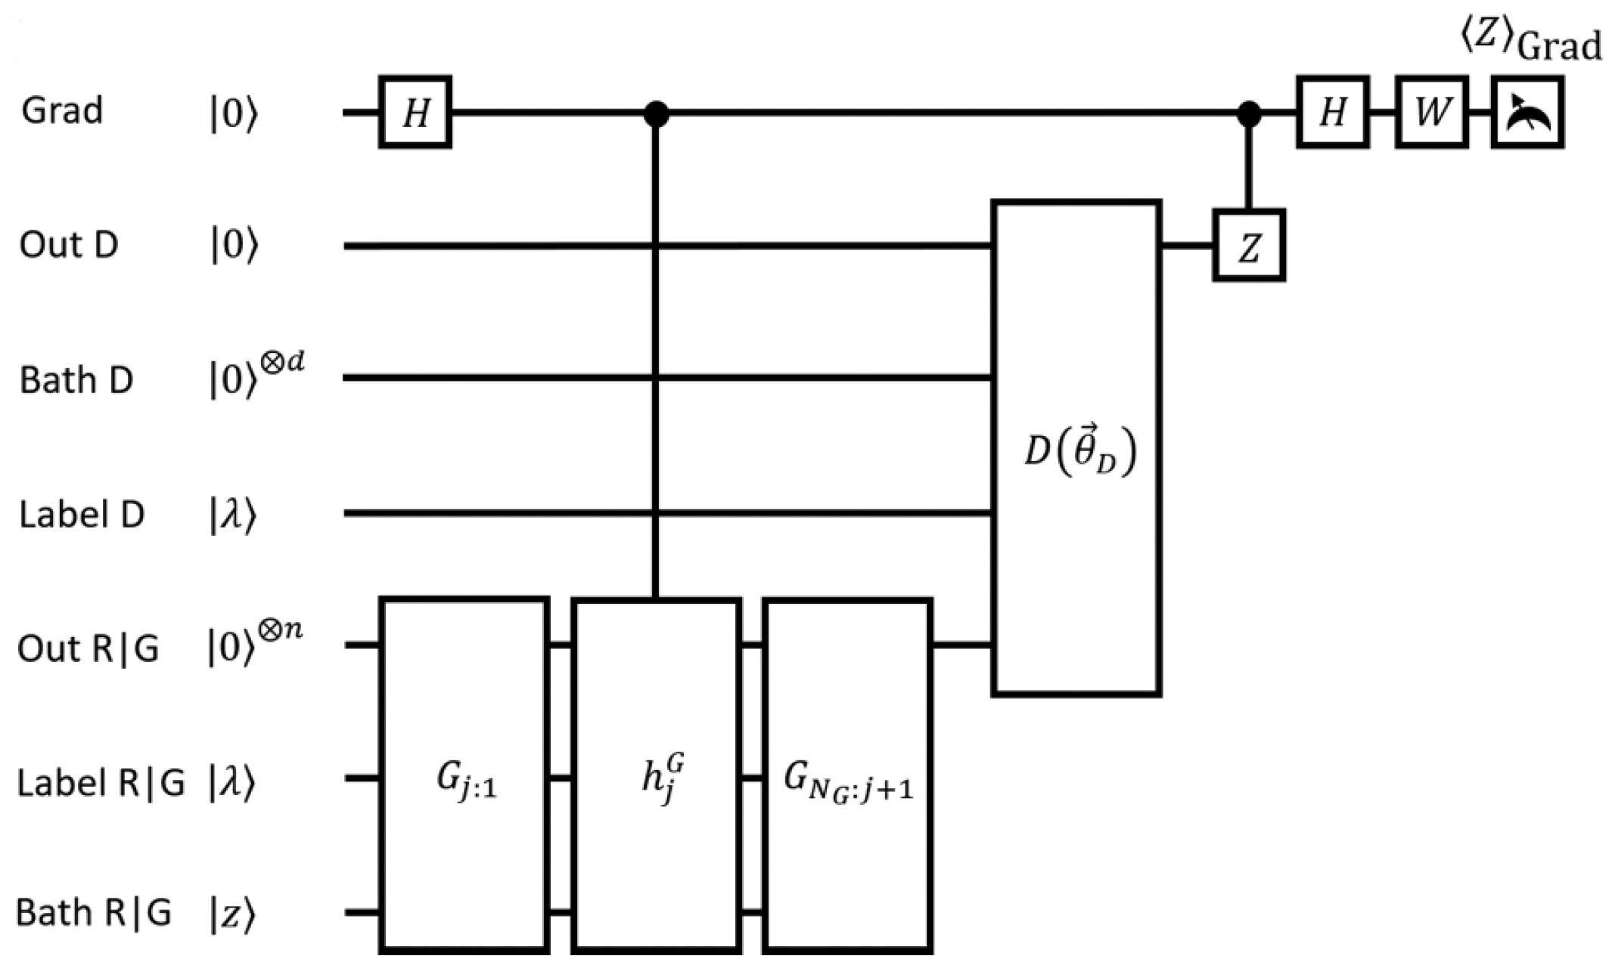
Quantum Circuits for Gradient
Measuring gradient of the generator
Measuring gradient of the discriminator

Slide 25
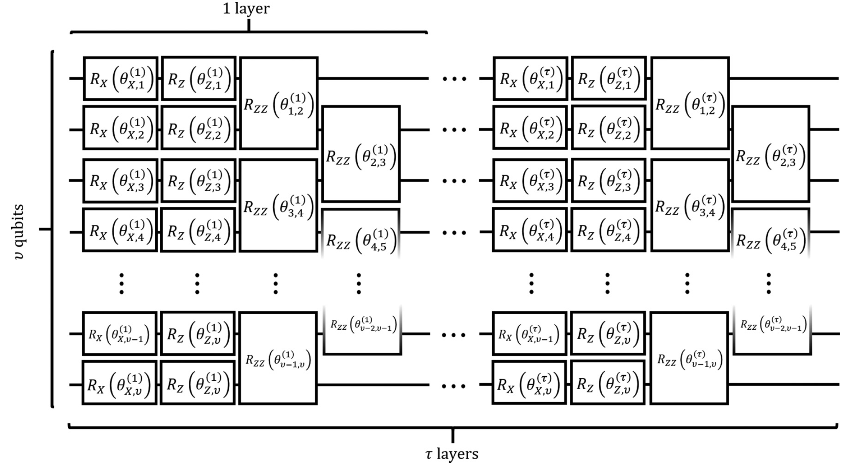
A Practical Circuit Ansatz
The ansatz is universal for quantum computing as all universal gates can be implemented with a polynomial number of layers τ.
Each layer is composed of single-qubit X rotations, Z rotations and two staggered sets of nearest-neighbor ZZ rotations.

Slide 26
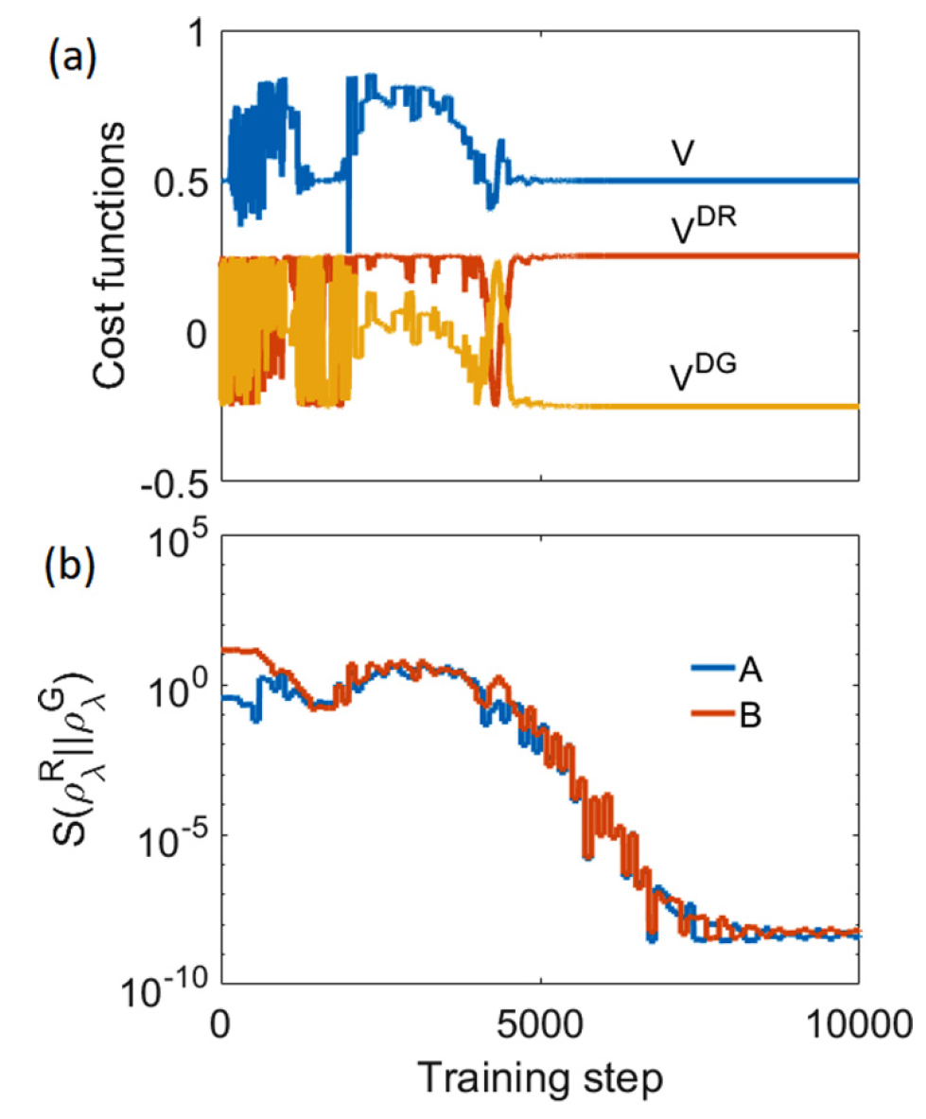
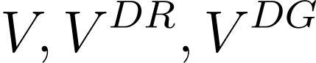
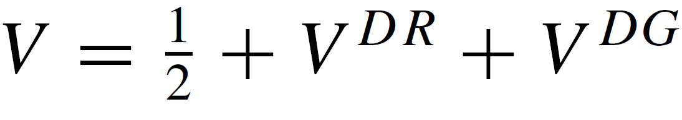
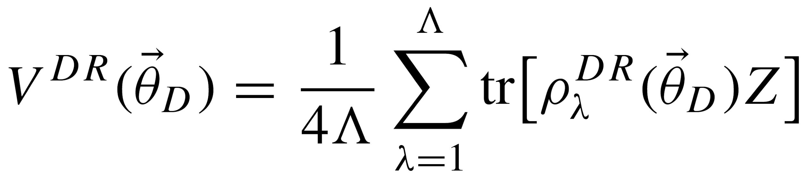
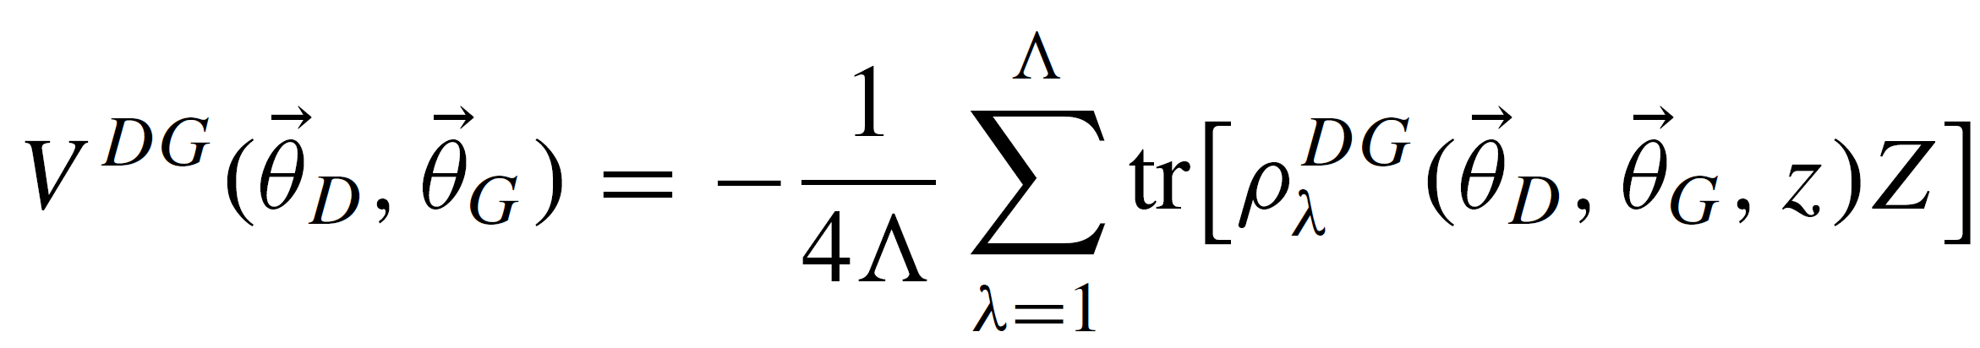
Numerical Analysis
As you can see in figure(b) on the right, the cross-entropy converges to zero, which means the generator has been properly trained.
are plotted on figure(a). At first, the parameters are chosen randomly. And as the training steps goes V converges to 0.5 which means D cannot differentiate R from G.
Where are

Slide 27
An Example of QuGAN Application
Decryption
A large enough QuGAN could learn to generate encrypted data labeled by RSA public encryption key.
In that case, the optimal generator would learn a statistical model of the unencrypted data for each key and encrypt with the label.
Other classical cryptographic systems (such as elliptic curve) could also be vulnerable to this type of attack.

